Slide 1


TEAM MITRA
.
ARTH
MITRA
Your Optimal Financial Consultant
YOUR FINANCIAL FUTURE
IN
YOUR
HANDS

Slide 2

TEAM MITRA
What
Is it Necessary
We Building
Yes, it is necessary to make an individual financially sustainable by making them self-aware and self-knowledgeable in financial terms. Through Financial-self-awareness any individual can obtain:
a) Informed decision-making
b) Effective money management
c) Avoiding financial pitfalls
d) Set financial goals
Our Goal of this project is to make every
Individual Smarter and Self-Aware of being
Finanicially Sustainable and Knowledgable.

Slide 3

TEAM MITRA
PROBLEM STATEMENT
Empowering Financial Sustainability & Awareness
Overview: Many individuals struggle with financial stability due to limited financial literacy and poor budgeting.
Key Challenges:
Objectives:
.
• Ineffective budget management
.
• Over-reliance on external support
• Insufficient financial planning awareness
.
• Enhance financial literacy
• Improve budgeting skills
Budget Management
.
• Promote self-reliance and long-term financial planning
Strategic
Objective

Slide 4
TEAM MITRA
Solution Statement
Empowering Financial Sustainability & Awareness
The "Financial Analyser and Knowledge Base" mobile app will empower users with financial sustainability through:
Real-time Financial Analysis: Automated tracking, visual reports, personalized budgets, and savings goal monitoring.
Comprehensive Financial Knowledge Base: Educational content, interactive tools, and up-to-date financial information in multiple languages.
Empowering
Digital Growth

Slide 5
Tech Stack - I
TEAM MITRA
FRONTEND TECHNOLOGIES
REACT (FRONTEND FRAMEWORK)
REACT NATIVE (MOBILE FRAMEWORK)
EXPO (DEVELOPMENT PLATFORM)
EXPO ROUTER (NAVIGATION)
REACT NAVIGATION
NATIVE WIND (STYLING)
TAILWIND CSS (STYLING)
REACT NATIVE REANIMATED (ANIMATION)
REACT NATIVE GESTURE HANDLER (INTERACTION)
EXPO LINEAR GRADIENT (UI)
REACT NATIVE CHART KIT (DATA VISUALIZATION)
VICTORY NATIVE (DATA VISUALIZATION)
BACKEND TECHNOLOGIES
SUPABASE (DATABASE, OAUTH, STORAGE)
EXPO AUTH SESSION (AUTHENTICATION)
EXPO SECURE STORE (SECURITY)
ASYNCSTORAGE (LOCAL DATA PERSISTENCE)
PRGM. LANG
JAVASCRIPT
TYPESCRIPT
CSS

Slide 6
Tech Stack - II
TEAM MITRA
DATA FORMATS
JSON (DATA FORMAT)
SVG (VECTOR GRAPHICS)
DEV TOOLS
BABEL (TRANSPILER)
TYPESCRIPT COMPILER (TRANSPILER)
POSTCSS (CSS PROCESSING)
AUTOPREFIXER (CSS PROCESSING)
EXPO APPLICATION SERVICES (EAS)(DEPLOYMENT)
API & SERVICES
NEWS API (EXTERNAL API)
SMS RETRIEVER (DEVICE API)
MOBILE PLATFORM SUPPORT
ANDROID (API LEVEL VARIES)
IOS (MODERN VERSIONS)
WEB (MODERN BROWSERS)
AI AND MACHINE LEARNING
GOOGLE GEMINI API (GEMINI 2.0)

Slide 7
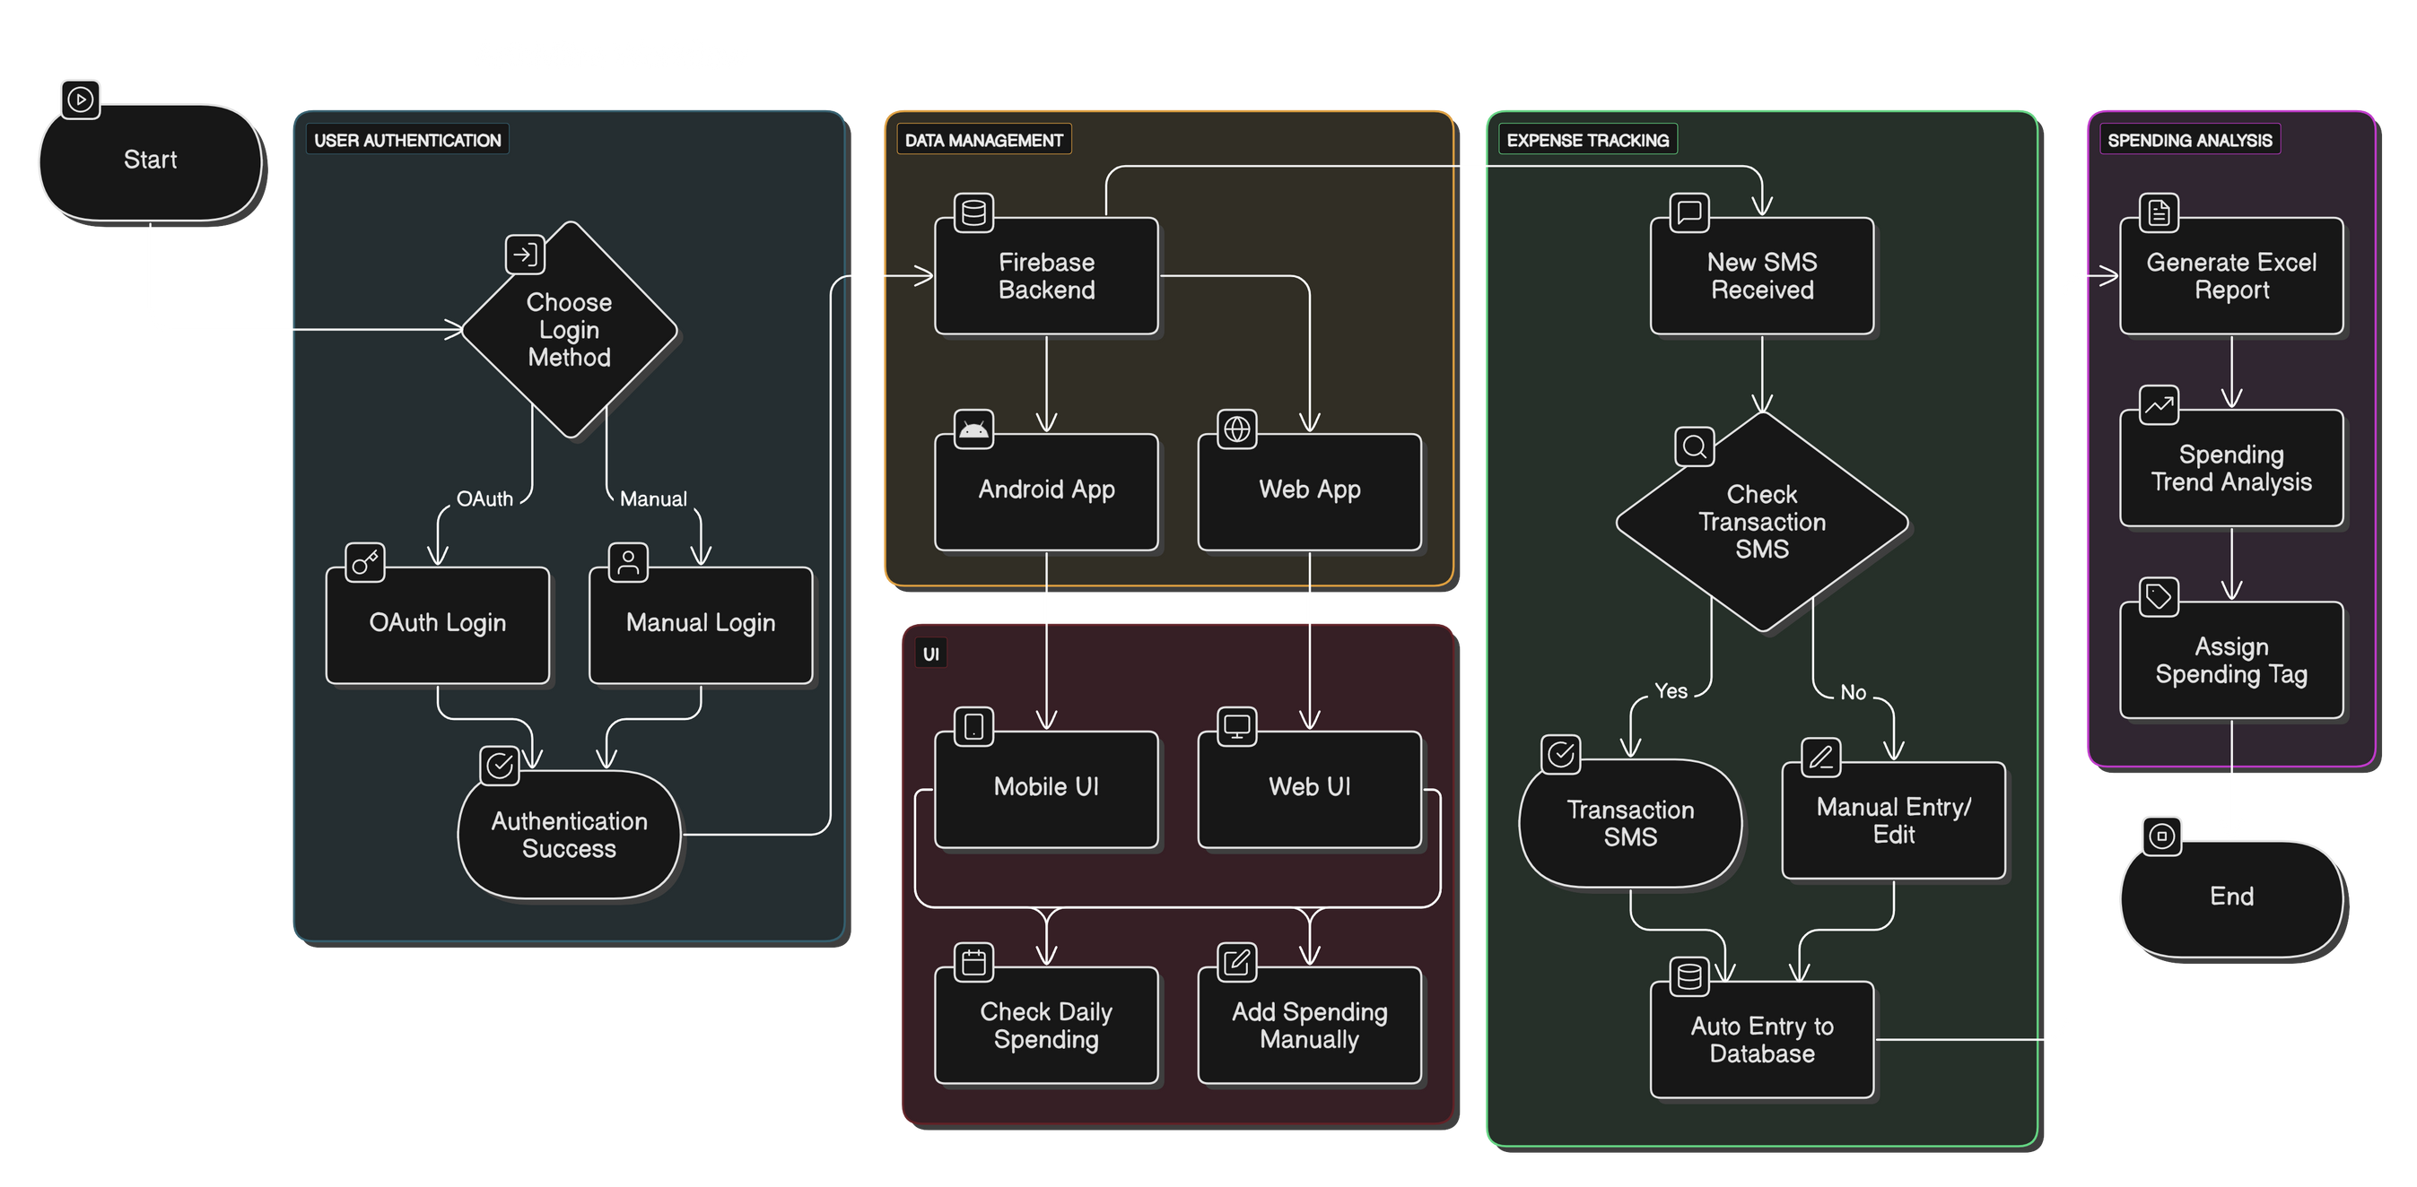
WORKFLOW OVERVIEW OF ARTHMITRA
TEAM MITRA

Slide 8

TEAM MITRA
Work Breakdown Structure
Front-End
Back-End
Integration
Testing & Integration Testing
Reviewing

Slide 9
TEAM MITRA
Time Management
Building Real Time Financial Tracker System
Data Training Challenges
Model Precision Challenges
Poor Integration between Codes (If)
Loss of Data
Changes in Real Time Data
Inadequate User Knowledge
KEY CHALLENGES TO ENCOUNTER

Slide 10
TEAM MITRA
Each member in our team has their fixed
responsibilities:
FRONT-END: GOURAB KUNDA ROY AND SOUNAK CHAKRABORTY
BACK-END & DATABASE: APURVA SARKAR & SOUNAK CHAKRABORTY
THESIS AND PAPER: SOUNAK CHAKRABORTY & APURVA SARKAR
INTEGRATION TESTING: GOURAB KUNDA ROY
AUTOMATED TRANSACTIONS TESTING: SURYA SARKAR
API INTEGRATION AND TESTING : SOUNAK CHAKRABORTY
BUNDLING AND LOCAL BUILD: APURVA SARKAR
EAS BUILD: SOUNAK CHAKRABORTY AND SURYA SARKAR
END USER FUNCTIONALITY TESTING: SURYA SARKAR
DASHBOARD INTEGRATION: SOUANK CHAKRABORTY AND GOURAB KUNDA ROY
Key Responsibilities

Slide 11
TEAM MITRA
Our Presentation culminated with a clear and compelling conclusion..
This application represents a holistic approach to financial health. It combines the power of real-time data analysis with the crucial foundation of financial education, empowering users to not only manage their current finances but also to make informed decisions for their future. By fostering a deeper understanding of financial concepts, we are building a foundation for sustainable financial success.
Data-Driven
Decision Making

Slide 12
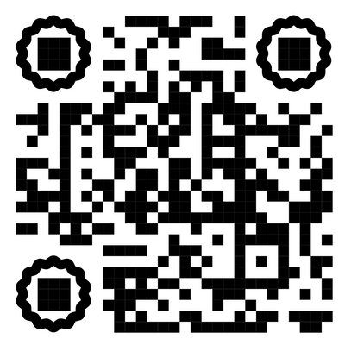
TEAM MITRA
Thank You
WANT TO KNOW MORE ABOUT ARTHMITRA OR EAGER TO SEE THE EARLY DEVELOPMENT
PHASES OF ARTHMITRA SCAN THE QR BELOW OR VISIT US AT
https://arth-mitra-landing-page.vercel.app/
Please feel free to ask any questions or provide feedback.
Contact Us at:
Arthmitraofficial@outlook.com

